Slide 1
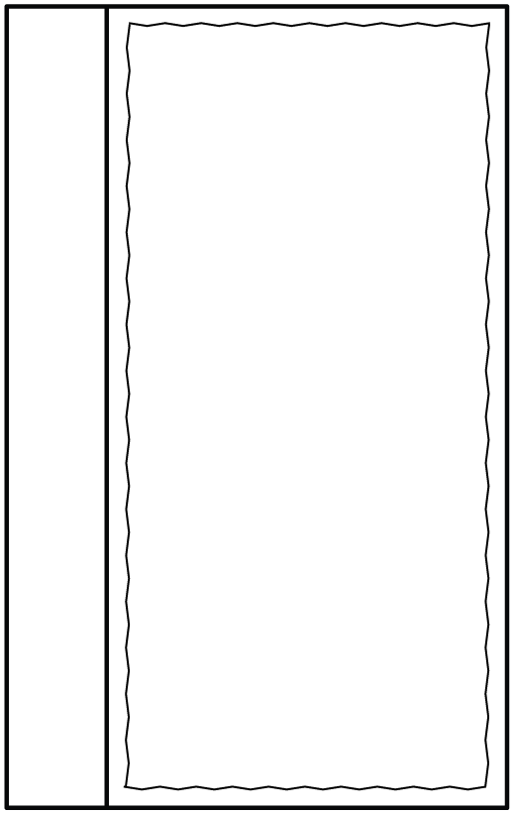
1 -3 b
Tab Singles – Small Rectangle
© 2014 erin cobb freenotebooktemplates.com

