Slide 1
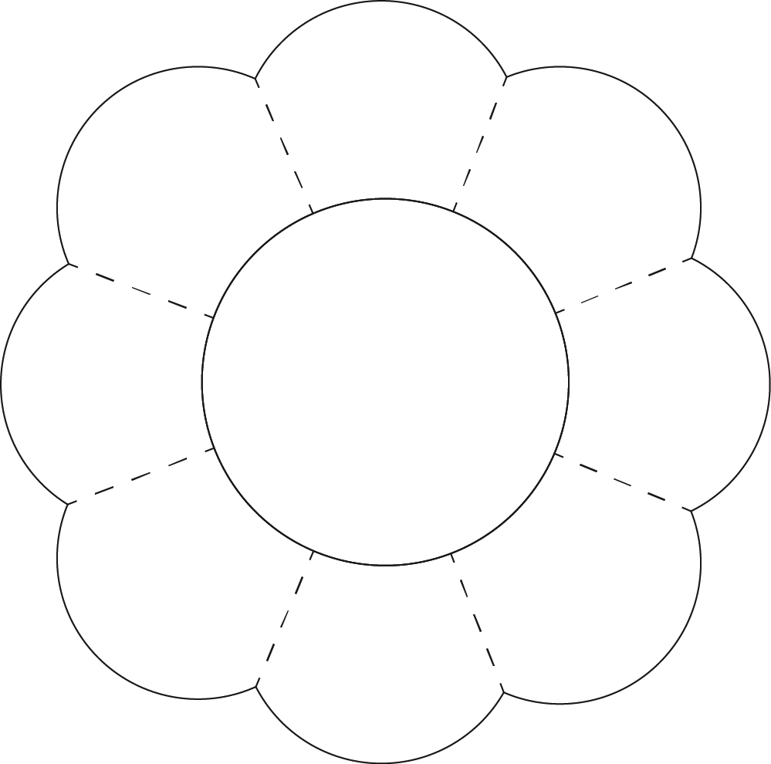
5 -1
Fun Shapes – 8 Petal Flower
© 2014 erin cobb freenotebooktemplates.com

