Slide 1
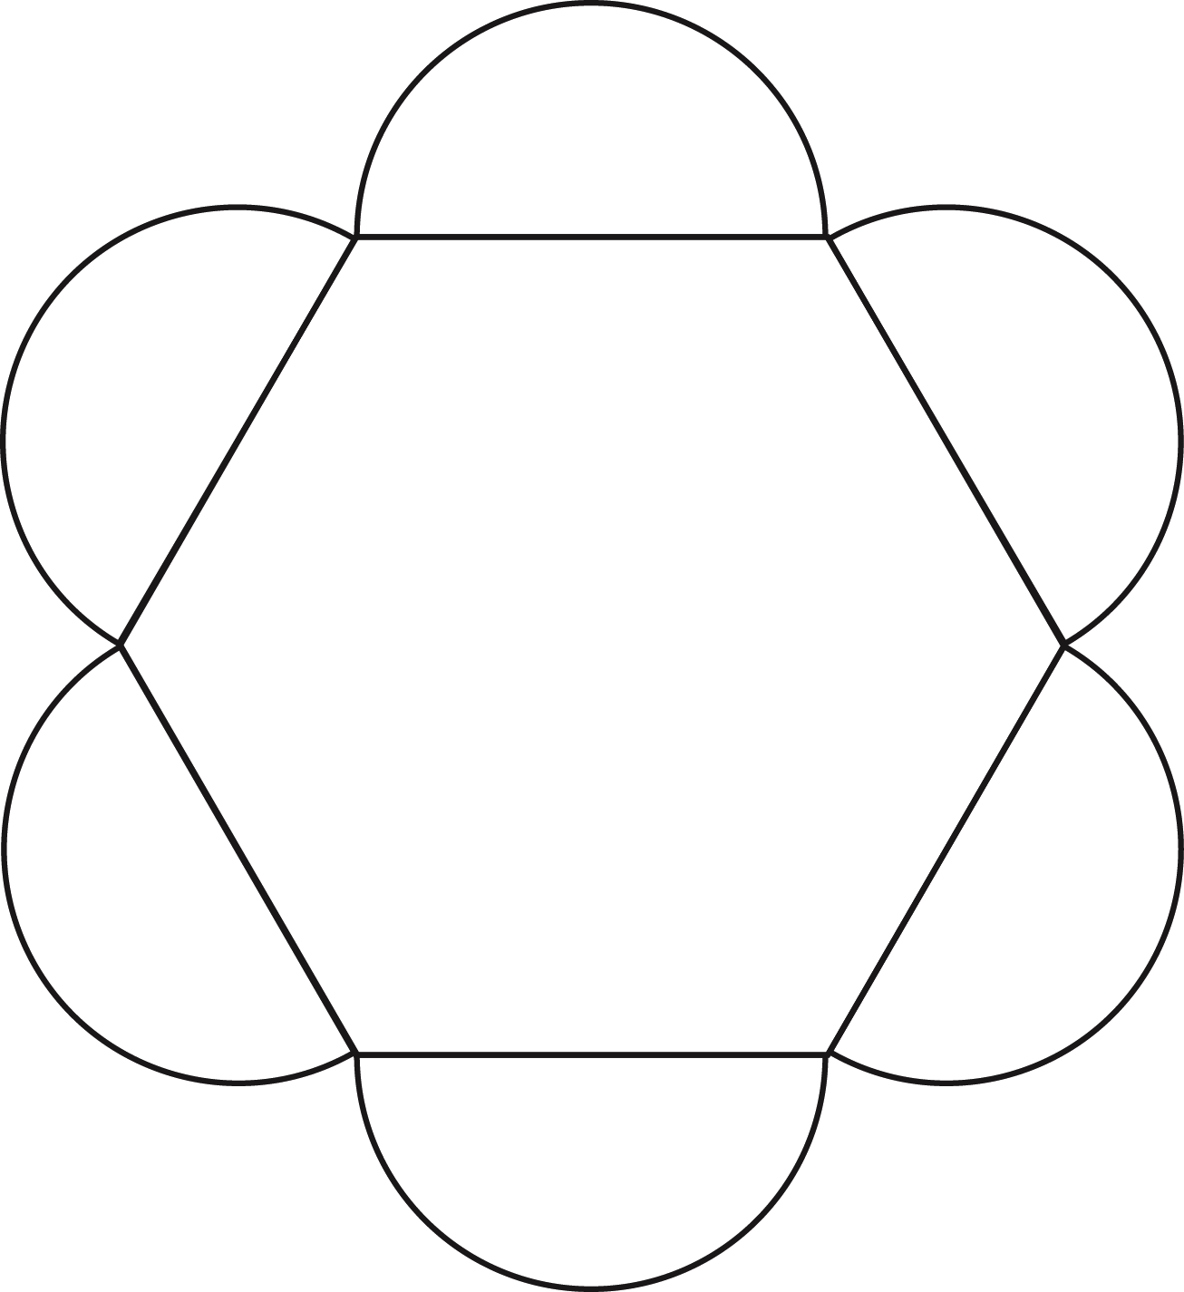
5 -4
Fun Shapes – 6 Petal Hexagon
© 2014 erin cobb freenotebooktemplates.com

