Slide 1
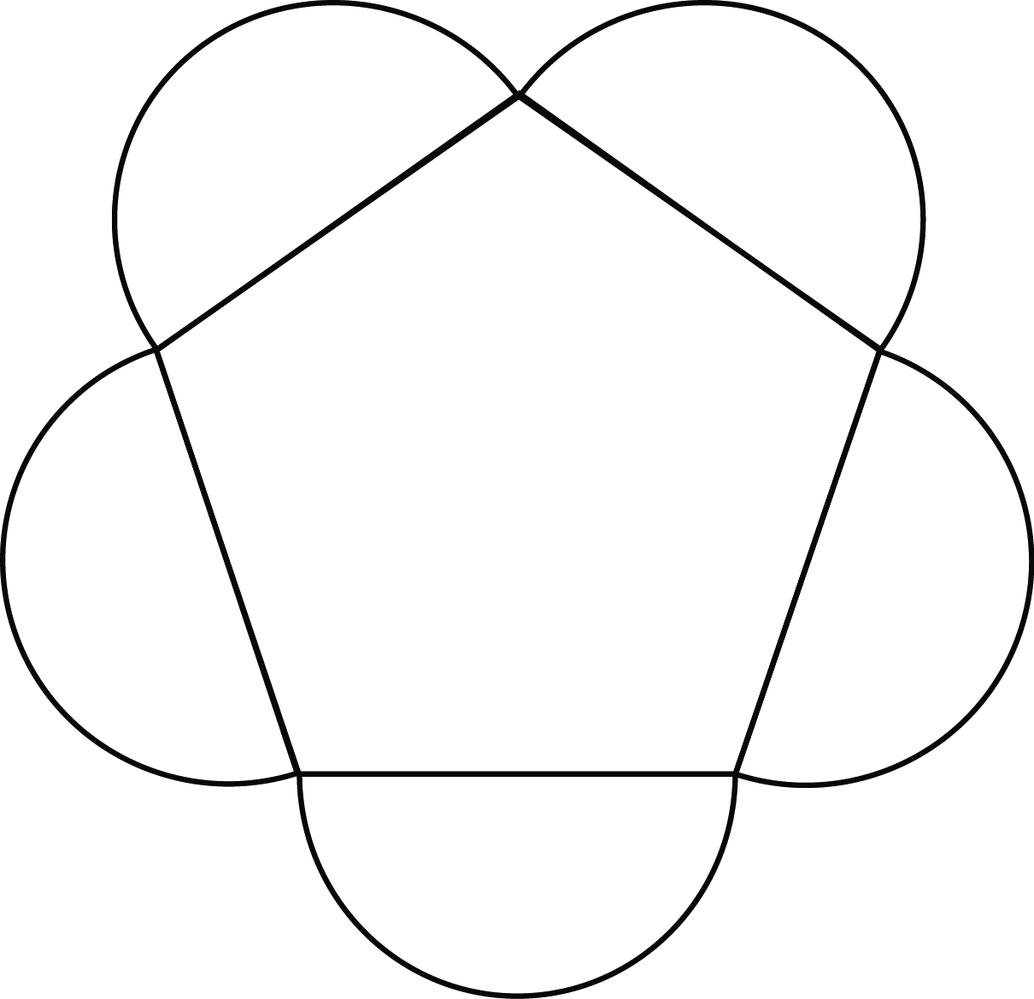
5 -3
Fun Shapes – 5 Petal Pentagon
© 2014 erin cobb freenotebooktemplates.com

