Slide 1
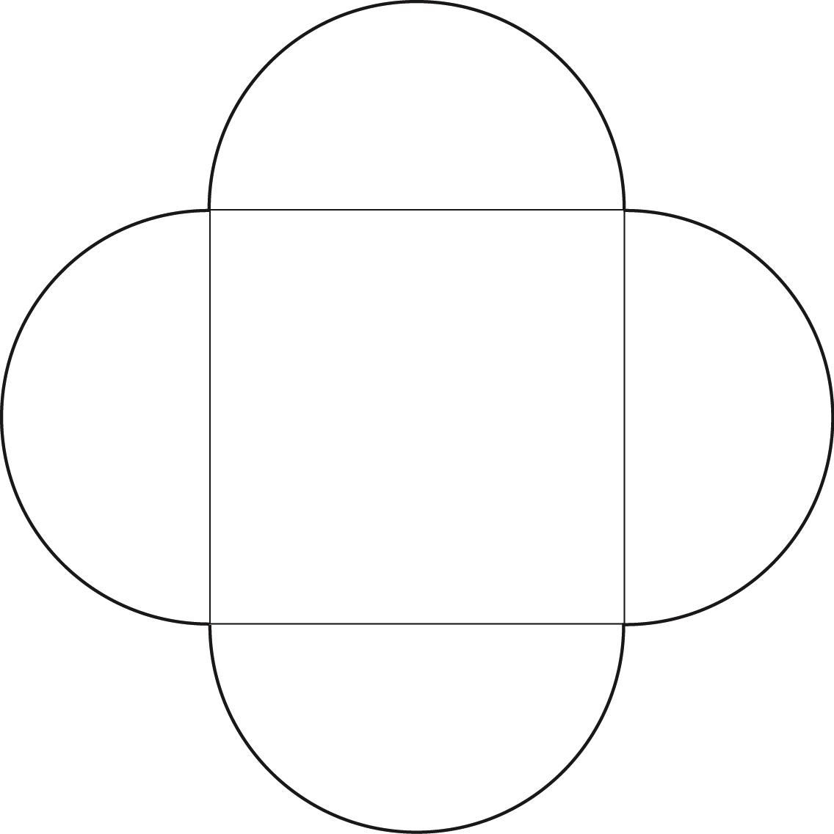
5 -5
Fun Shapes – 4 Petal Square
© 2014 erin cobb freenotebooktemplates.com

