Slide 1
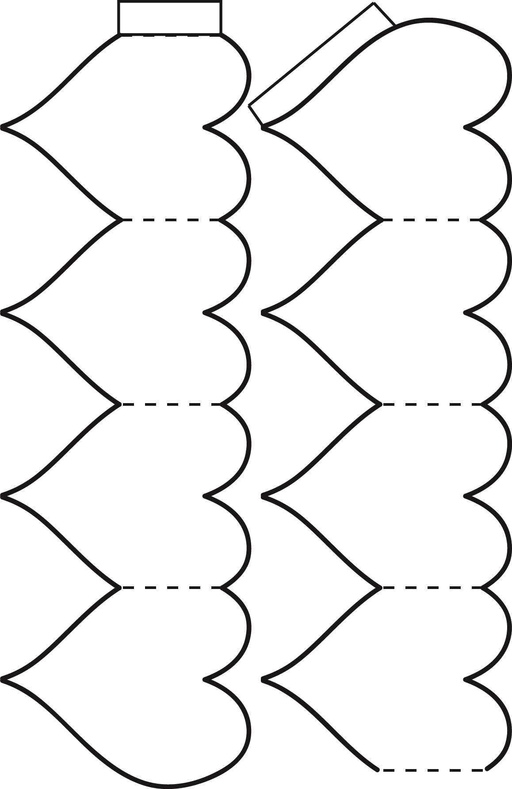
4 -6
Accordion – 8 Heart
© 2014 erin cobb freenotebooktemplates.com

